Slide 1

POLITECNICO DI TORINO
COLLEGIO DI INGEGNERIA INFORMATICA, DEL CINEMA E MECCATRONICA
M.SC. IN MECHATRONIC ENGINEERING
ROS over the Internet:
developing a VPN-based ROS network to enable remote communication using a
3D printed robot hand
Supervisors: Prof. Paolo Prinetto
Supervisors at HotBlack Robotics:
Ph.D. Ludovico Orlando Russo
Ph.D. Gabriele Ermacora
​Author: Cesare Pecone​

Slide 2
OUTLINE AND MOTIVATION
ROS over the Internet:
developing a VPN-based ROS network to enable remote
communication using a 3D printed robot hand
Introduction
Robotics & Service Robots
Cloud Computing & Cloud Robotics
The PARLOMA Project
State of the art
Open Issues
Developed Solution
Robot Operating System (ROS)
Virtual Private Network (VPN)
Docker
Conclusions
Future Developments

Slide 3
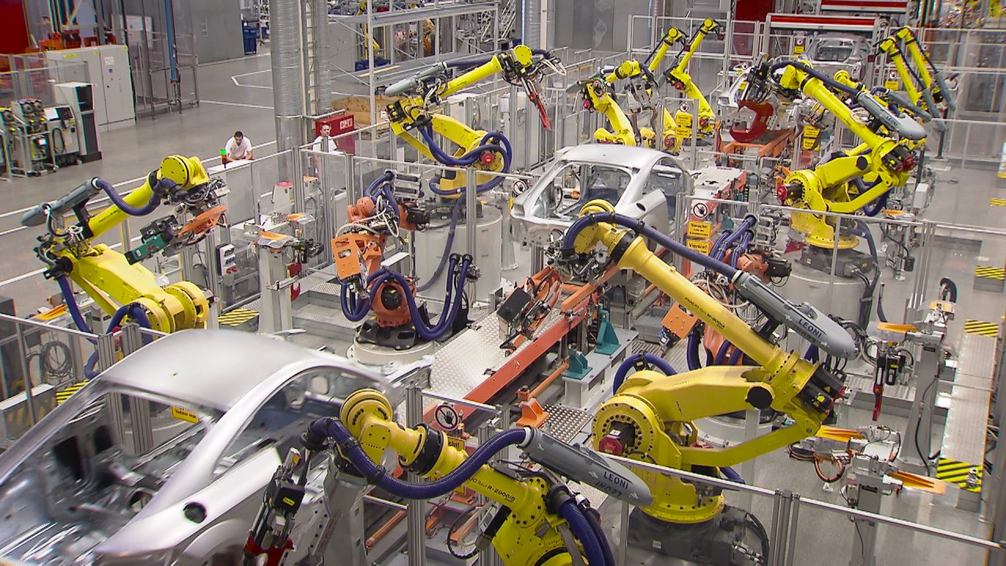

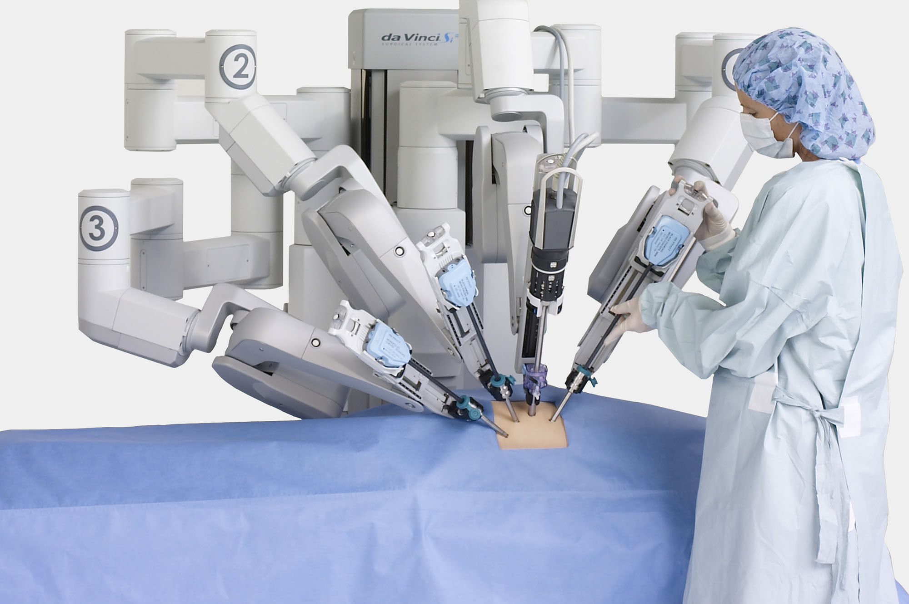
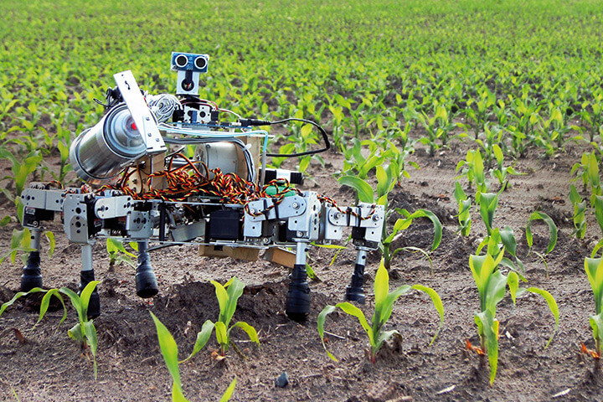
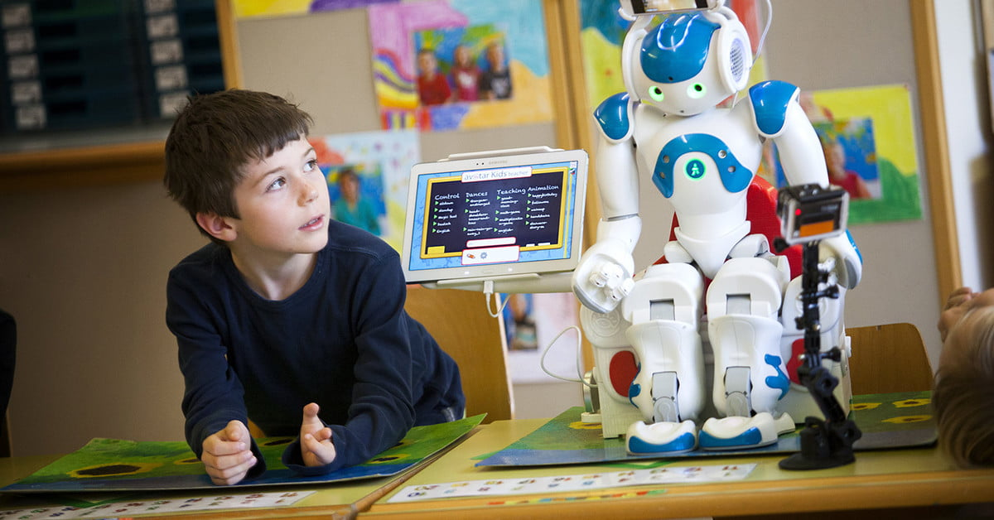
ROBOTICS
Industrial Robots
Exploration and Scientific Robots
Medical Robots
Service robotics
Agricultural Robots
Edu-tainments Robots
I. Introduction | 1

Slide 4
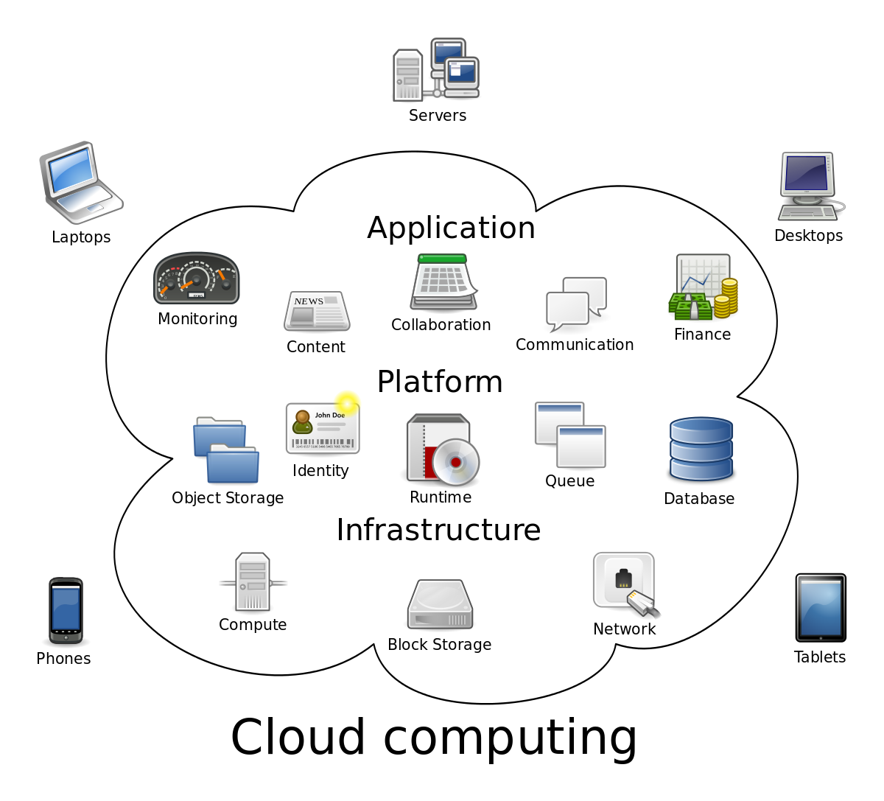
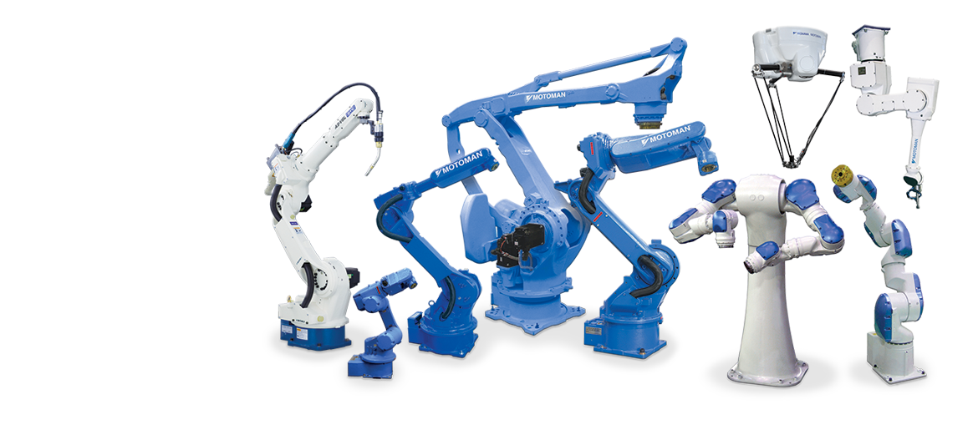
CLOUD COMPUTING
ROBOTICS
I. Introduction | 2

Slide 5

CLOUD COMPUTING
ROBOTICS
I. Introduction | 2
‘’Humans as a species are becoming more intelligent because we are able to share information much more quickly and take advantage of innovations faster, even
robots have that potential’’ K.G.
2

Slide 6






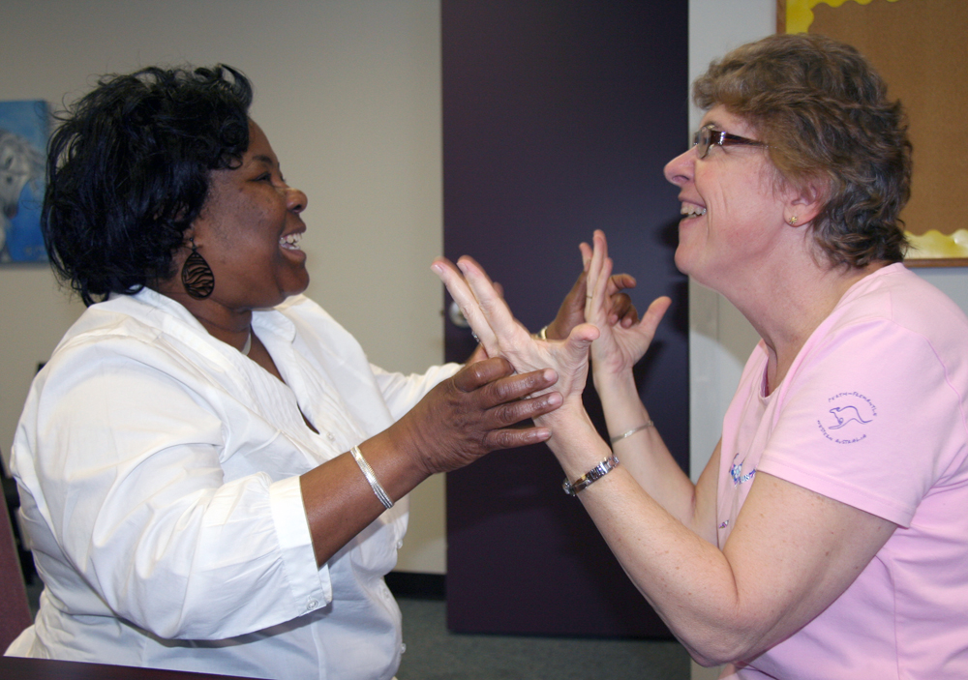
THE PARLOMA PROJECT
II. The Parloma Project | 3
The PARLOMA project allows remote communication between:
two deafblind people
a deafblind person to a deaf person
deafblind person to a hearing person with a knowledge of sign language
3

Slide 7
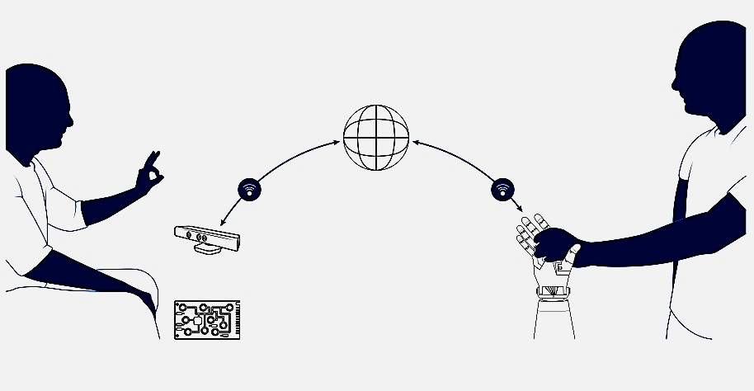
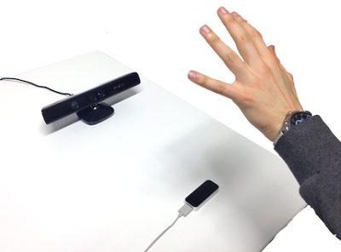
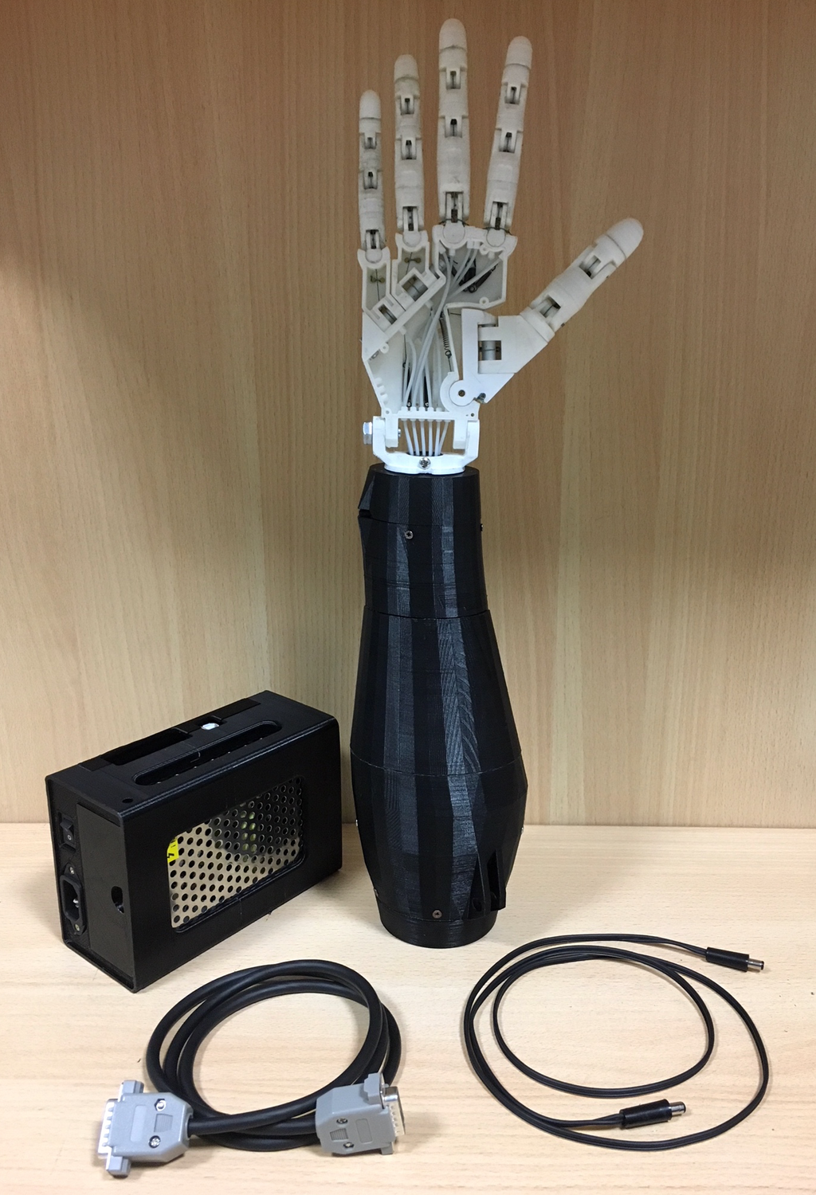
THE PARLOMA PROJECT
II. The Parloma Project | 4
Hand Tracking
Gestures reproduction
DATA TRANSMISSION

Slide 8
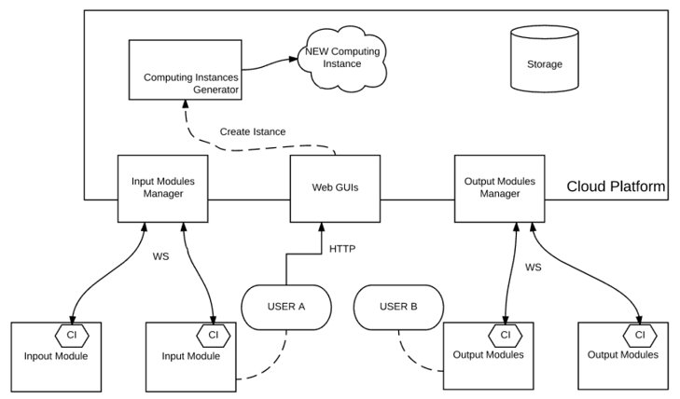
PARLOMA ARCHITECTURE – STATE OF ART
II. The Parloma Project | 5
5

Slide 9

PARLOMA ARCHITECTURE – STATE OF ART
II. The Parloma Project | 5
Local Area Network
Open Issues
?
?
LAN A
LAN B
LAN C
LAN D
5

Slide 10
ROBOT OPERATING SYSTEM (ROS)
III. Developed Solution | 6
ROS Environment
on a LAN
A framework designed for robotics application developments.
Each actor involved in PARLOMA, such as I/O modules and Platform, performs within it some processes called ROS nodes.
These nodes communicate between them exchanging messages on topics.
Cloud Platform
MASTER
Node
output/serial_topic
Joint_command
Input Module​
Output Module
Publisher
Node
Subscriber
Node

Slide 11
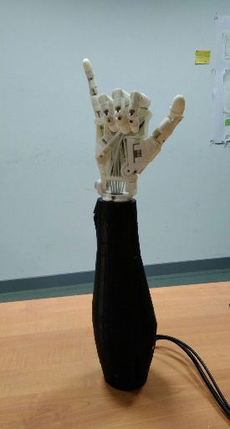
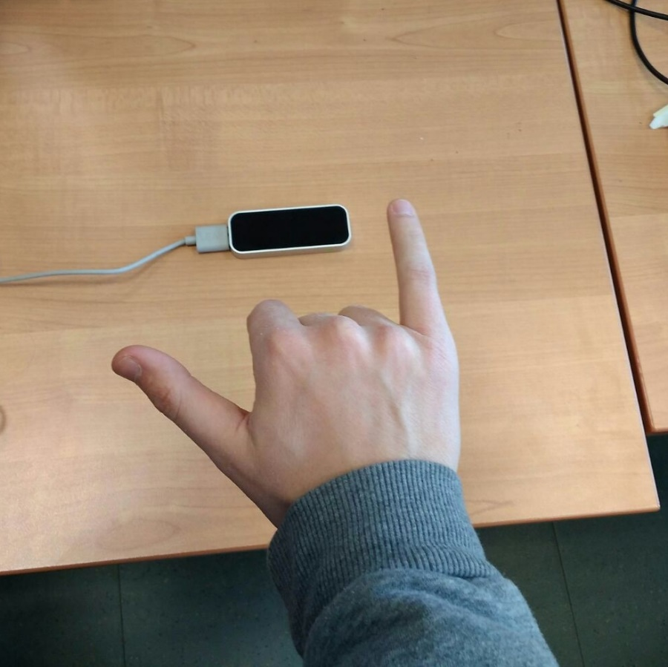
ROBOT OPERATING SYSTEM (ROS)
III. Developed Solution | 6
ROS Environment
on a LAN
A framework designed for robotics application developments.
Each actor involved in PARLOMA, such as I/O modules and Platform, performs within it some processes called ROS nodes.
These nodes communicate between them exchanging messages on topics.
Cloud Platform
MASTER
Node
[180, 0, 0, 0, 180] ​
output/serial_topic
Joint_command
[π, 0, 0, 0, π] ​
Input Module​
Output Module
Publisher
Node
Subscriber
Node

Slide 12
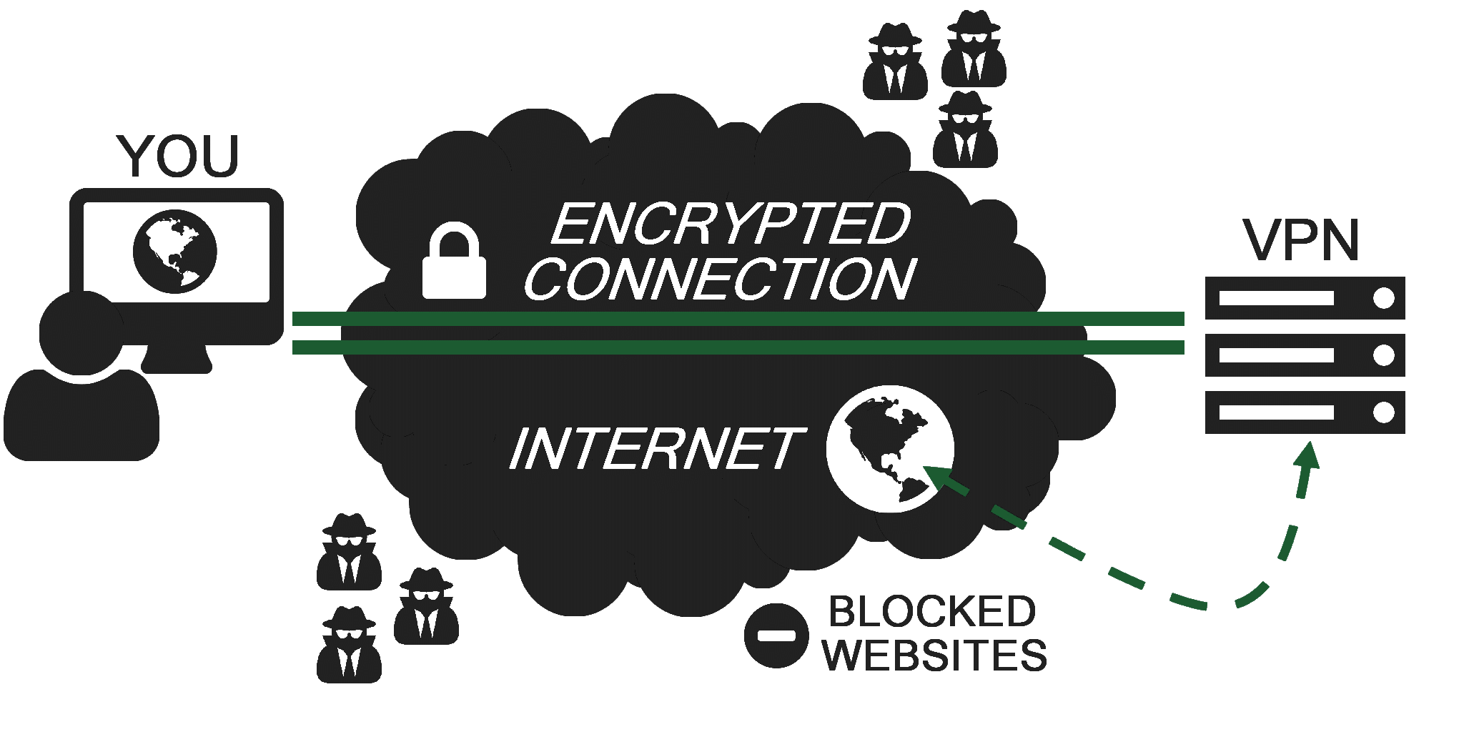
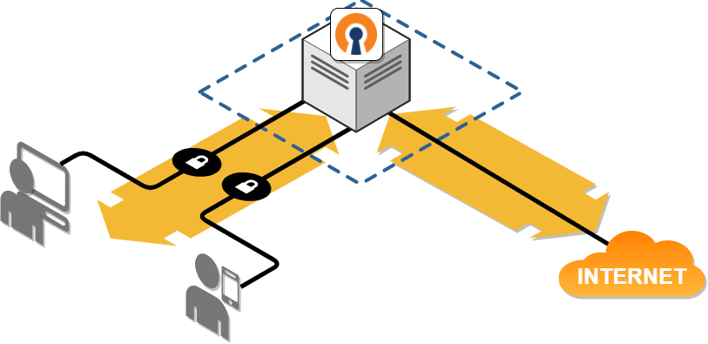

VIRTUAL PRIVATE NETWORK (VPN)
III. Developed Solution | 7
A network technology that embeds all the ROS equipped devices in the same network, assigning each of them a unique IP address, regardless their corresponding LAN.

Slide 13
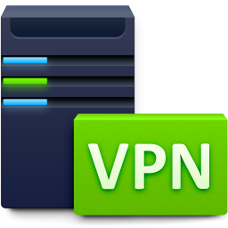
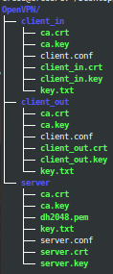
VIRTUAL PRIVATE NETWORK (VPN)
III. Developed Solution | 8
client
dev tun
proto tcp
remote serveripaddress 1194
resolv-retry infinite
nobind
persist−key
persist−tun
ca ca.crt
cert client_in.crt # or client_out.crt
key client_in key # or client_out.key
remote−cert−tls server
tls−auth key.txt 1
cipher AES−256−CBC
Server
Input
Client
Output Client
port 1194
proto tcp
dev tun
ca ca.crt
cert server.crt
key server.key
dh dh2048.pem
server 10.8.0.0 255.255.255.0
ifconfig−pool−persistipp.txt
keepalive 10 120
tls−auth key.txt 0
cipher AES−256−CBC
persist−key
persist−tun
Necessary files to build a VPN solution:
Certification Authority
Server Certificate, Encryption Files and Server Key
Client Certificate and a Key Pair, for each client
Server configuration file
Clients configuration files
Run the service

Slide 14
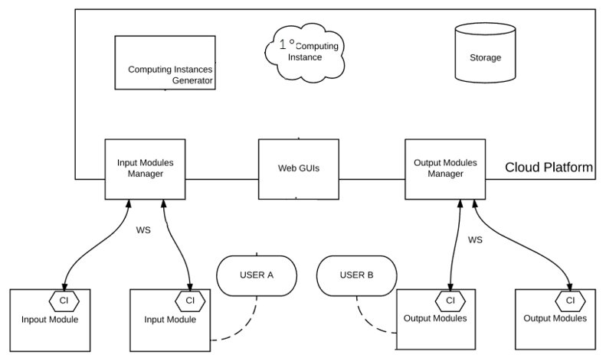
III. Developed Solution | 9
PARLOMA ARCHITECTURE – VPN SOLUTION
VPN
LAN A
LAN B
LAN C
LAN D
5

Slide 15
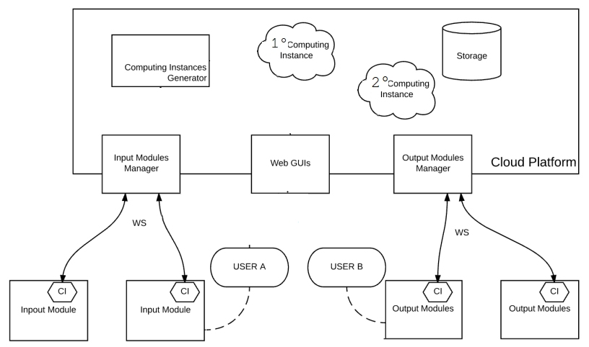
PARLOMA ARCHITECTURE
III. Developed Solution | 10
VPN
?
USER C
USER D
LAN A
LAN D
LAN B
LAN C

Slide 16
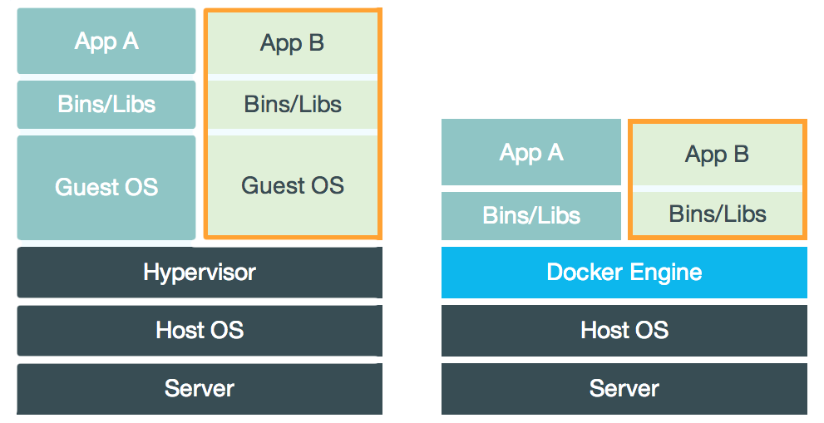
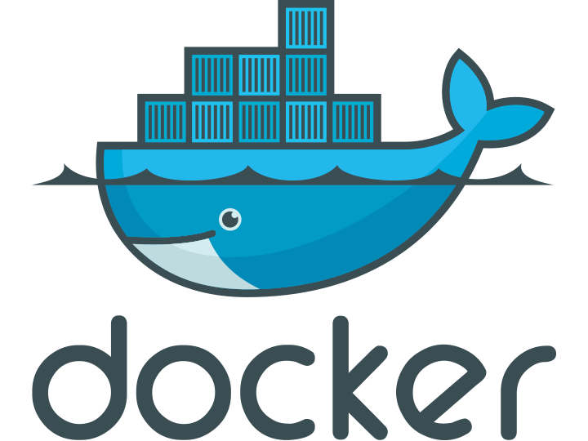
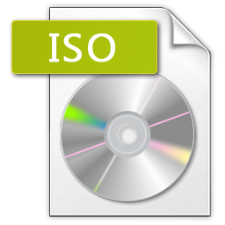
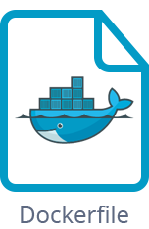
DOCKER
III. Developed Solution | 11
VIRTUAL MACHINE
DOCKER
An operating-system-level virtualization software that allows to run multiple application instances (containers).

Slide 17
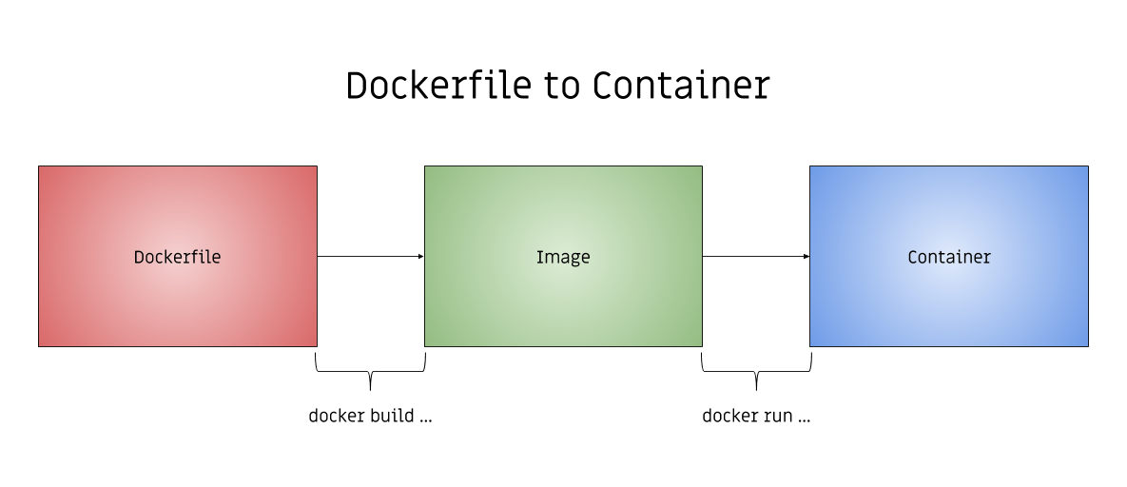
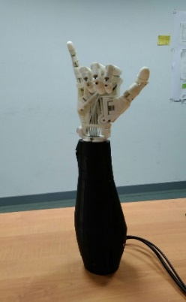

DOCKER
III. Developed Solution | 12
Cloud Platform
[180, 0, 0, 0, 180] ​
output/serial_topic
MASTER
Joint_command
[π , 0, 0, 0, π ]
Input Module​
Output Module
FROM osrf/ros:indigo-desktop-full
RUN \
svn checkout https://github.com/creos92/parloma.git/trunk/Client &&\
svn checkout https://github.com/creos92/parloma.git/trunk/parloma_ros &&\
apt-get update &&\
apt-get install build-essential checkinstall -y &&\
apt-get install libssl-dev liblzo2-dev libpam0g-dev wget -y &&\
wget https://swupdate.openvpn.org/community/releases/openvpn-2.4.4.tar.gz &&\
sudo tar zxvf openvpn-2.4.4.tar.gz &&\
cd openvpn-2.4.4 && ./configure && make && checkinstall -y &&\
/bin/bash -c 'source /opt/ros/indigo/setup.bash && \ cd /parloma_ros && catkin_make'
CMD cd parloma_ros && chmod +rx start_c._in.sh && sync && ./start_c_out.sh
FROM osrf/ros:indigo-desktop-full
RUN \
svn checkout https://github.com/creos92/parloma.git/trunk/Client &&\
svn checkout https://github.com/creos92/parloma.git/trunk/parloma_ros &&\
apt-get update &&\
apt-get install build-essential checkinstall -y &&\
apt-get install libssl-dev liblzo2-dev libpam0g-dev wget -y &&\
wget https://swupdate.openvpn.org/community/releases/openvpn-2.4.4.tar.gz &&\
sudo tar zxvf openvpn-2.4.4.tar.gz &&\
cd openvpn-2.4.4 && ./configure && make && checkinstall -y &&\
/bin/bash -c 'source /opt/ros/indigo/setup.bash && \ cd /parloma_ros && catkin_make'
CMD cd parloma_ros && chmod +rx start_c._in.sh && sync && ./start_c_in.sh
FROM osrf/ros:indigo-desktop-full
RUN \
svn checkout https://github.com/creos92/parloma.git/trunk/Server &&\
svn checkout https://github.com/creos92/parloma.git/trunk/parloma_ros &&\
apt-get update &&\
apt-get install build-essential checkinstall -y &&\
apt-get install libssl-dev liblzo2-dev libpam0g-dev wget -y &&\
wget https://swupdate.openvpn.org/community/releases/openvpn-2.4.4.tar.gz &&\
sudo tar zxvf openvpn-2.4.4.tar.gz &&\
cd openvpn-2.4.4 && ./configure && make && checkinstall -y &&\
/bin/bash -c 'source /opt/ros/indigo/setup.bash && \ cd /parloma_ros && catkin_make'
CMD cd parloma_ros && chmod +rx start_s.sh && sync && ./start_s.sh
Publisher
Subscriber
ROS Environment
Over Internet

Slide 18
PARLOMA ARCHITECTURE – DOCKER SOLUTION
III. Developed Solution | 13
USER C
USER D
LAN A
LAN D
LAN B
LAN C

Slide 19
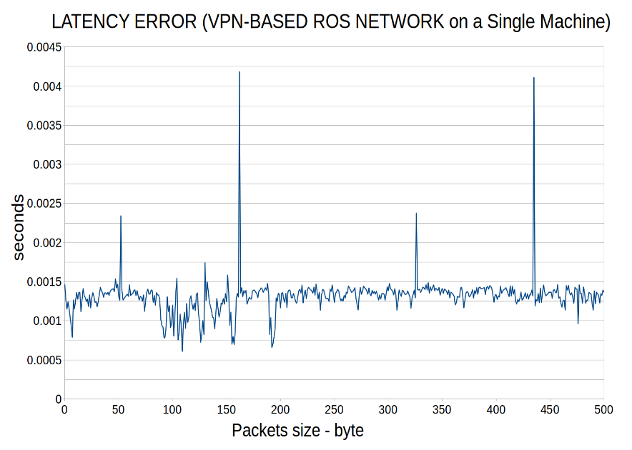
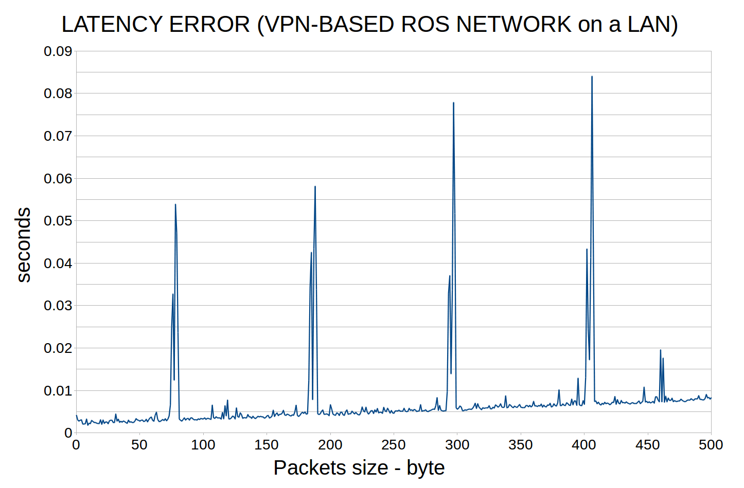
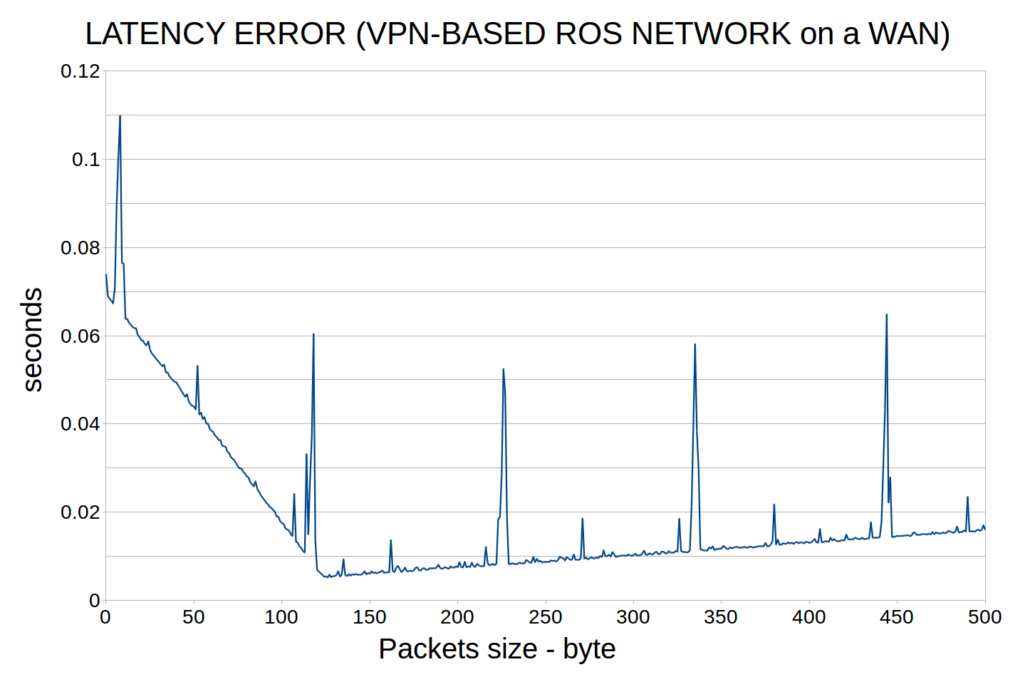
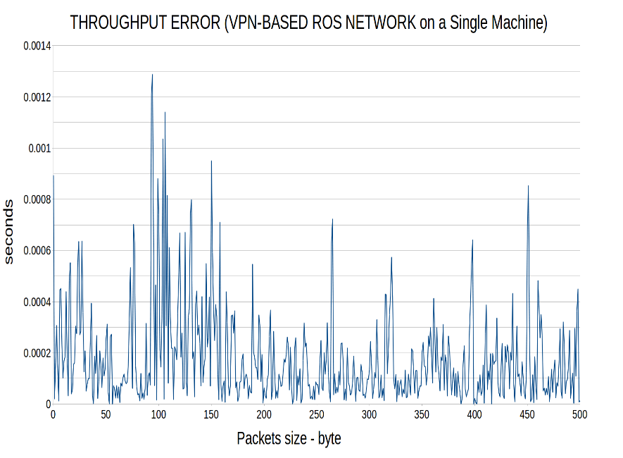
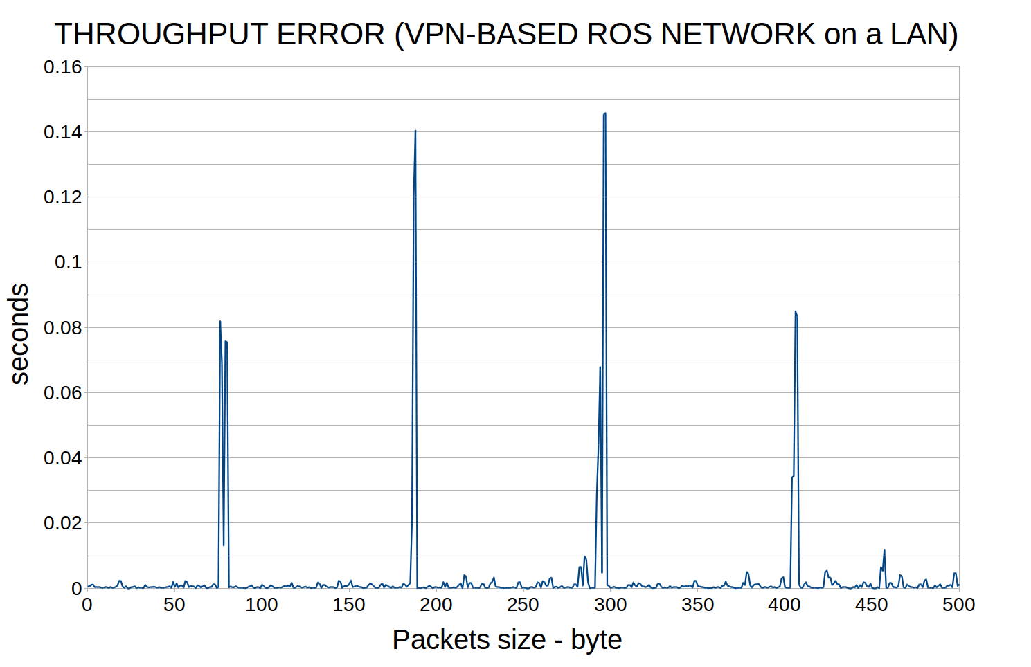
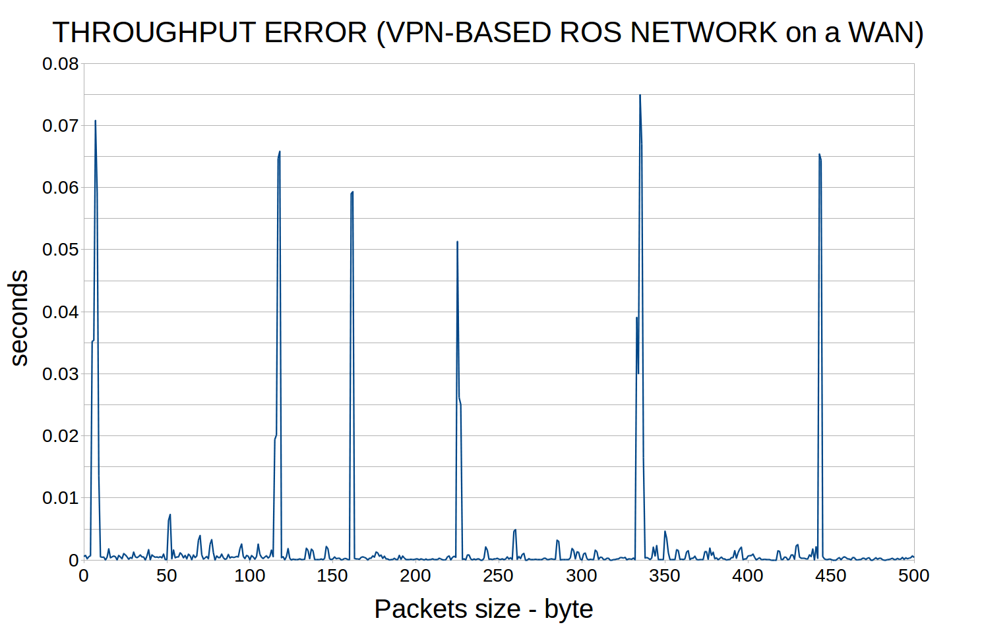
EXPERIMENTS
II. Developed Solution | 14
SINGLE - MACHINE
LOCAL AREA NETWORK
WIDE AREA NETWORK
15

Slide 20
EXPERIMENTS
II. Developed Solution | 15
LOCAL AREA
NETWORK
WIDE AREA
NETWORK
15

Slide 21
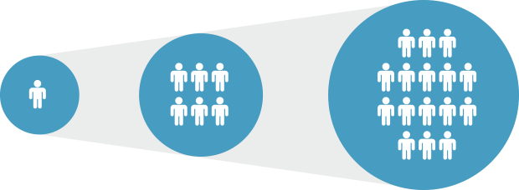
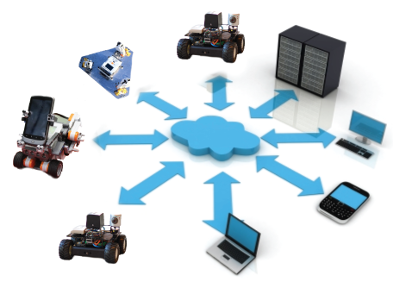

CONCLUSIONS
IV. Conclusion| 14
Developed Network
The architecture built succeeded in implementing external ROS networks, connected to different LANs.
The architecture is:
Highly scalable
Multi-platform
Robust
Flexible
The set up is extremely simple.

Slide 22
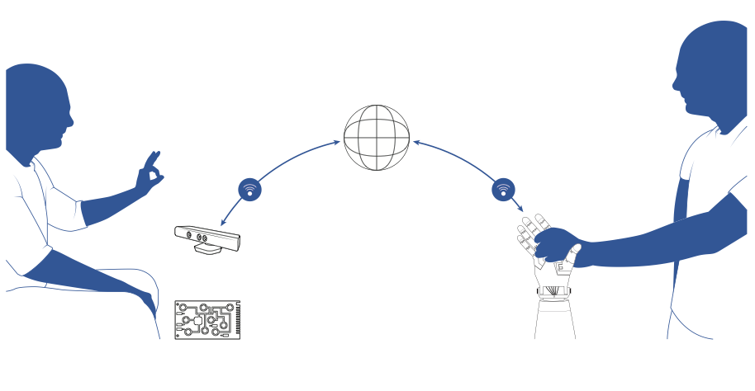
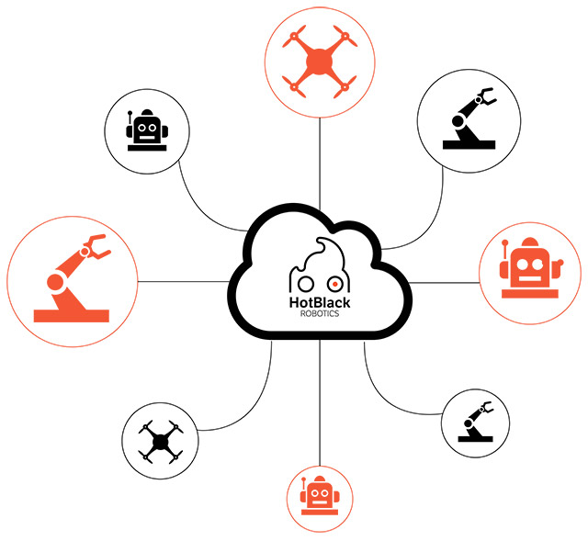
CONCLUSIONS
IV. Conclusion | 15
FUTURE DEVELOPMENTS
Deafblind people can communicate remotely with their interlocutors thanks to PARLOMA.
The architecture developed could be used for many Cloud Robotics applications.
The procedure to build the Certification Authority files, should automated
Security issues

Slide 23

Thank you for your attention

